Slide 1

Defense Against The Dark Arts: Application security and you
https://uk.pinterest.com/pin/335518240961936792/

Slide 2
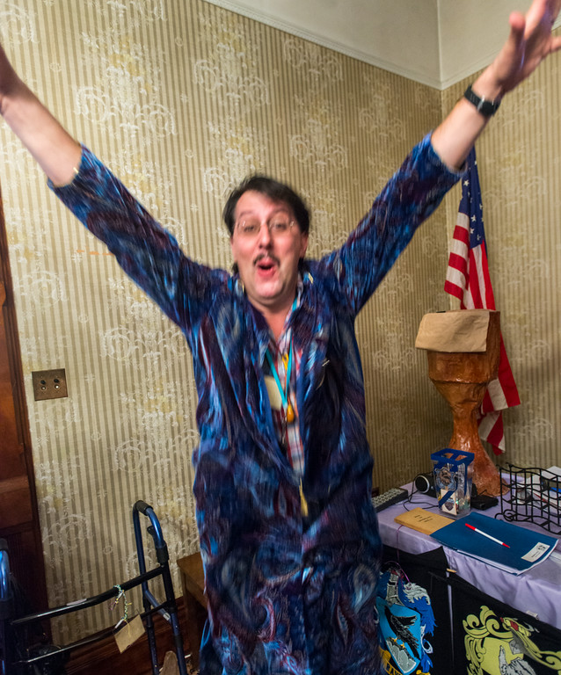
Joe Kuemerle
Over 15 years of development experience with a broad range of technologies
Focused on application and data
security, coding best practices
and regulatory compliance
Presenter at community, regional
and national events.
https://proftalon.smugmug.com/Hogwarts/2914-summer/i-v4tSLNL/A

Slide 3
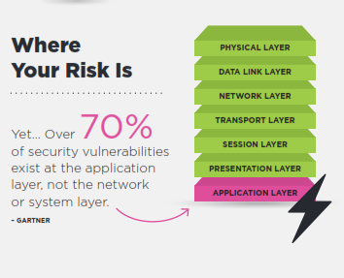
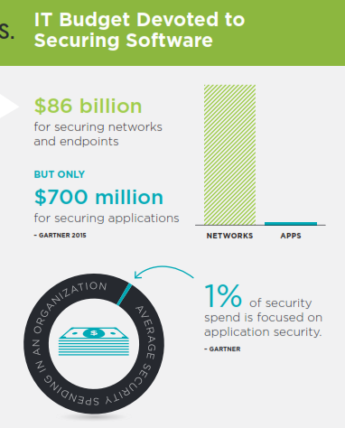
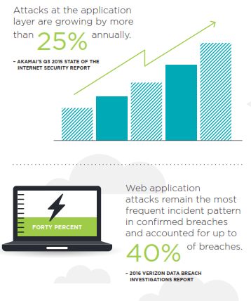
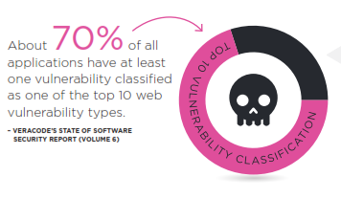
https://www.veracode.com/resources

Slide 4

http://cdn.quotesgram.com/small/79/88/1743520670-top-10.jpg
Notes:
OWASP Top 10

Slide 5
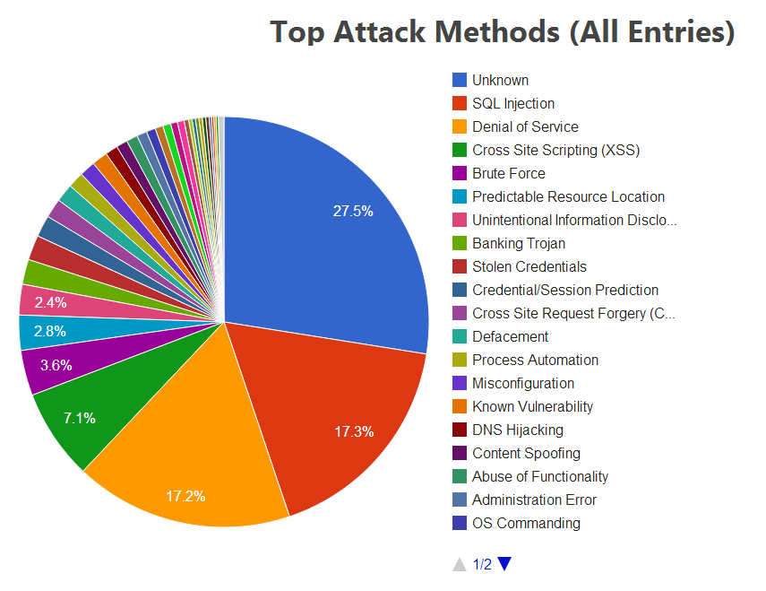
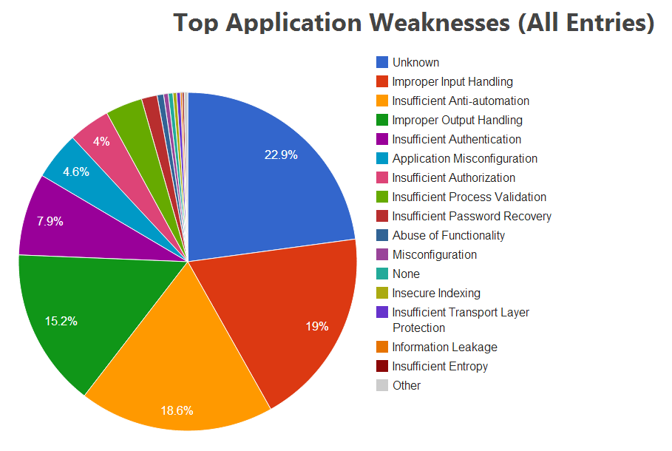
Source:
Web Hacking Incident Database
http://tinyurl.com/AppAttackStats

Slide 6
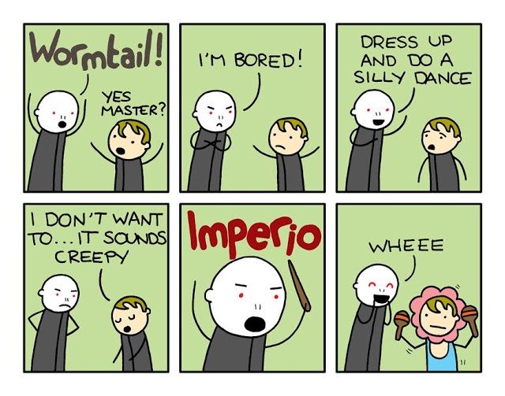
http://timothywinchester.blogspot.com/2010/05/harry-potter-you-know-who-is-totally.html
Notes:
SQL Injection

Slide 7
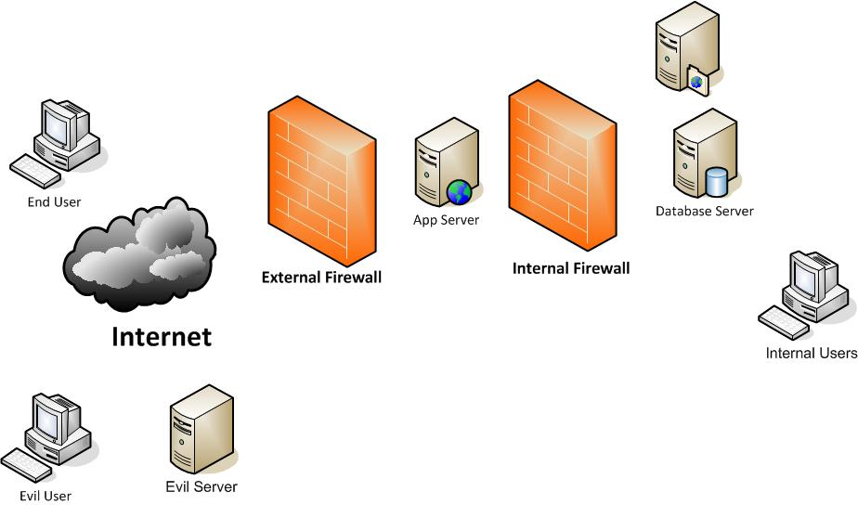

Slide 8
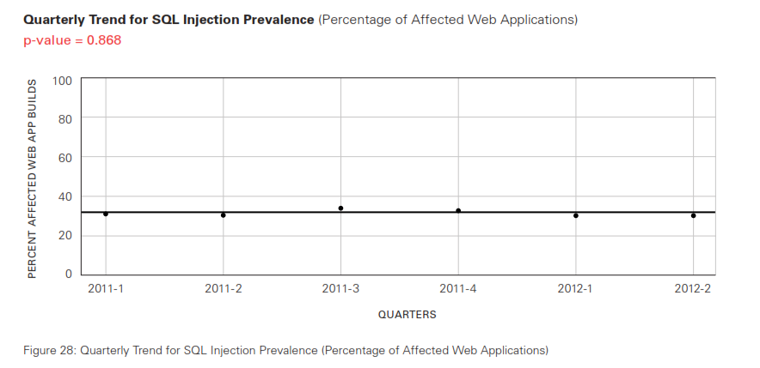
http://www.veracode.com/resources/state-of-software-security

Slide 9
http://codecurmudgeon.com/wp/sql-injection-hall-of-shame/
COMPANY | DATE | RESULTS | REFERENCE
Cisco email security appliances | 2016-09 | appliances running IronPort AsyncOS vulnerable to sql injection allowing root-level access | Cisco Warns of Critical Flaw in Email Security Appliances
i-Dressup teen social site | 2016-09 | up to 5.5 million passwords leaked in plain text. | Teen social site is leaking millions of plaintext passwords
US government servers in the .us top-level domain. | 2016-09 | usernames and passwords for "every FTP server on a .us domain" | Fear hacker claims he hit hundreds of government servers
MySQL | 2016-09 | unpatched vulnerability allows injection attack | Critical Mysql Vulnerability Disclosed
Arizona voter database | 2016-08 | data for 200,000 voters stolen | Hack that targeted Arizona voter database was easy to prevent
GTA Fan Forum | 2016-08 | email addresses, passwords and other profile data for 197,000 users. | GTAGaming Hack Blamed on old Vbulletin Software
vBulletin on 11 websites | 2016-08 | personal information for 27 million accounts from 11 websites | Hackers exploit vBulletin flaw to access 27M accounts on 11 websites
CodeIgniter | 2016-08 | Vulnerability in PHP framework - unknown breaches. | Future Hosting Advises Users of the CodeIgniter Framework to Update
ReadyDesk | 2016-08 | vulnerability found in help desk application used by more than 400,000 people. | CERT warns of vulnerabilities in ReadyDesk
Epic Games | 2016-08 | 80,000 users accounts from online forums | Epic Games Forums Hacked
Notes:
Philipino Votor Registration, TalkTalk,

Slide 10
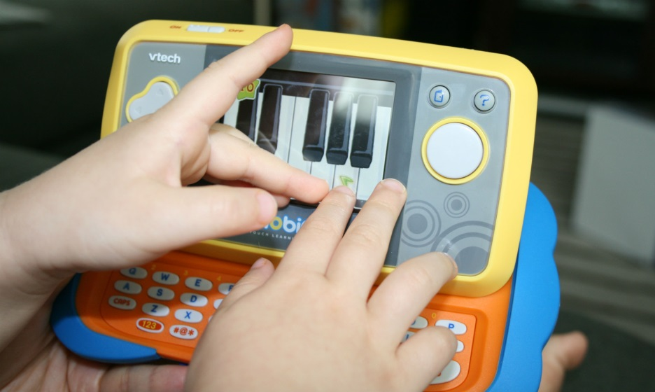
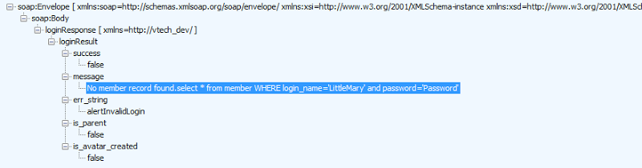
4.8 Million parents
6.3 Million children
http://motherboard-images.vice.com/content-images/article/28241/1448640227075896.jpg

Slide 11
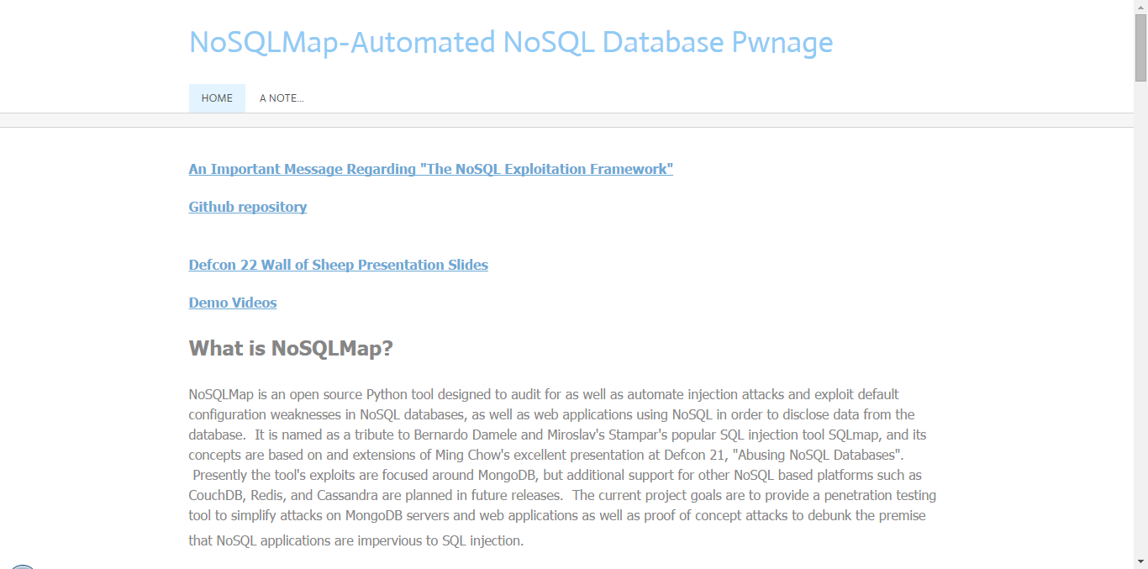
db.myCollection.find( { $where: function() { return obj.credits - obj.debits < 0; } } );
db.myCollection.find( { active: true, $where: function() { return obj.credits - obj.debits < $userInput; } } );;

Slide 12
Notes:
Demo injection

Slide 13
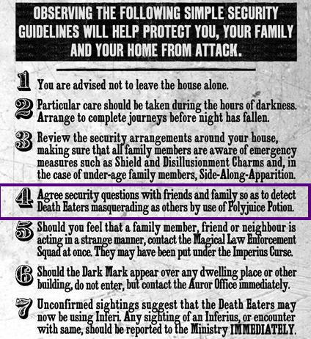
https://www.pinterest.com/pin/78531587227048328/
Notes:
Poor authentication and session management

Slide 14

https://www.pinterest.com/pin/299911656412432748/
Notes:
Cross site scripting

Slide 15
Notes:
Cross site scripting

Slide 17
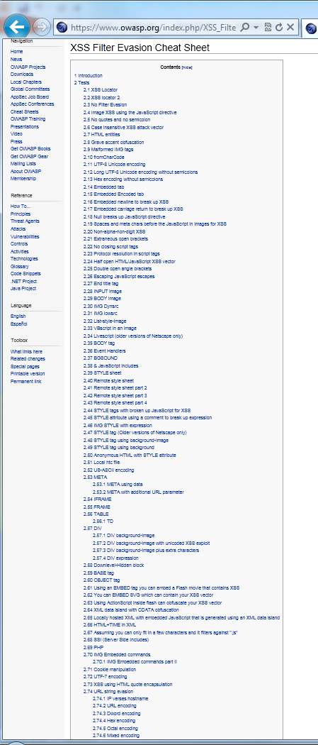
https://www.owasp.org/index.php/XSS_Filter_Evasion_Cheat_Sheet

Slide 18
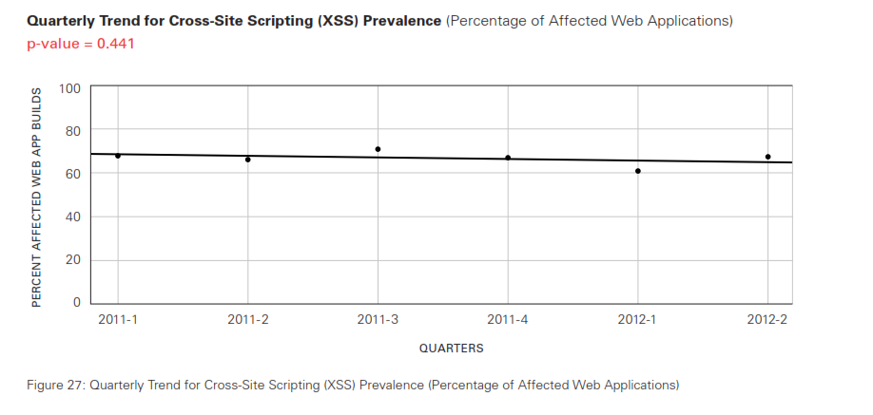
Notes:
XSS trendline

Slide 19
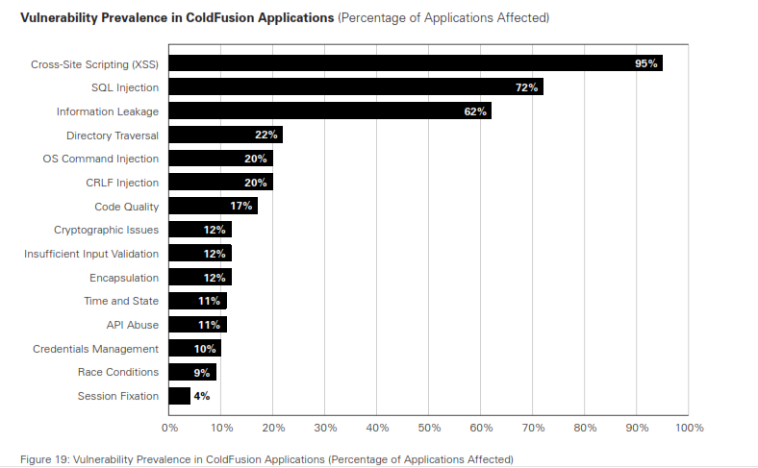
Notes:
No matter how bad it is at least you’re not running ColdFusion

Slide 20

Notes:
Direct Object Reference

Slide 21
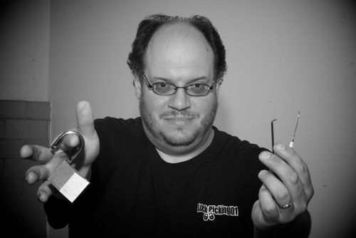
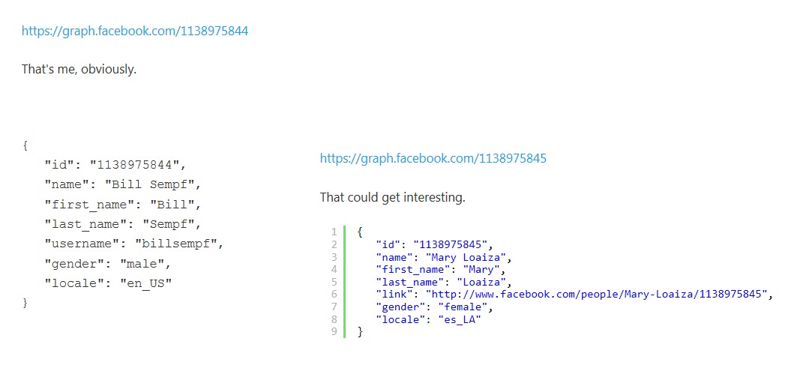
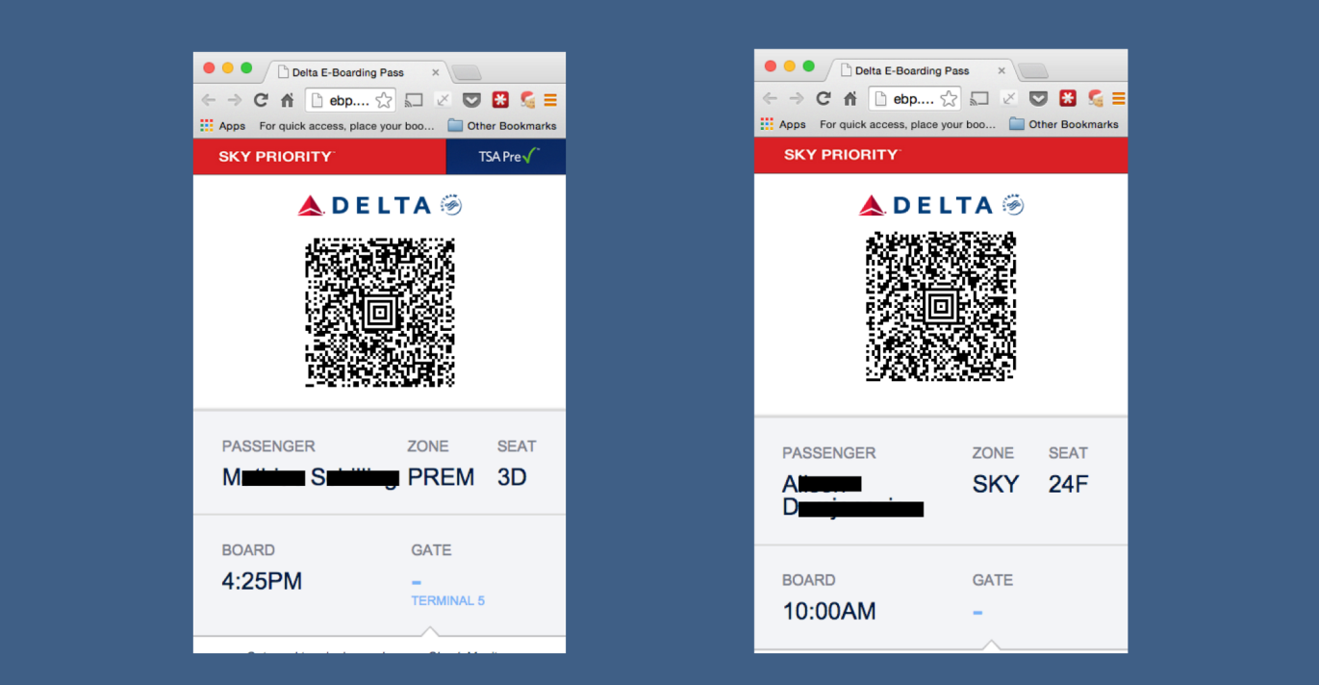
http://www.itnews.com.au/News/398892,delta-site-flaw-lets-passengers-access-other-boarding-passes.aspx

Slide 22
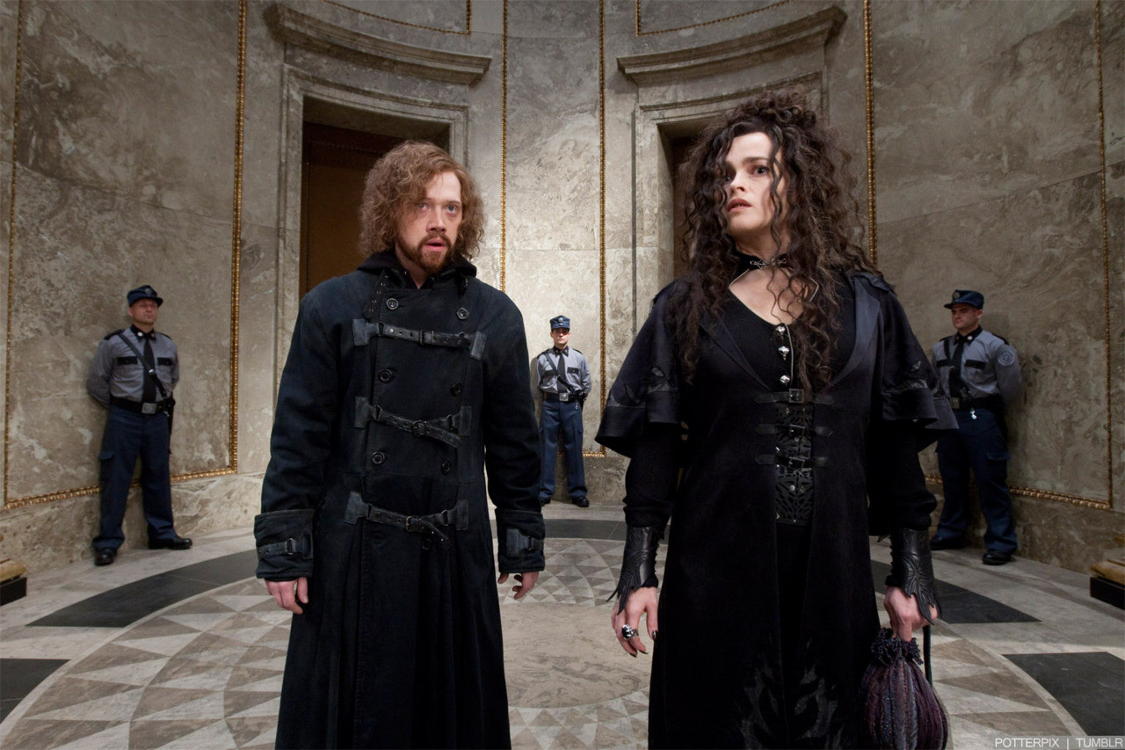
Notes:
Security Misconfiguration

Slide 23
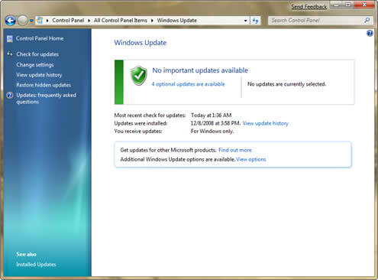
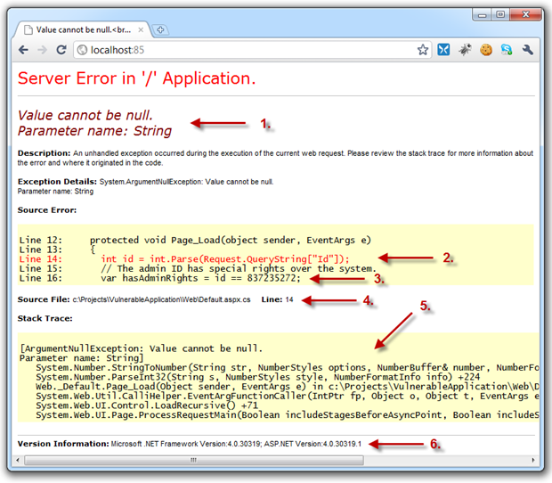
Notes:
Security Misconfiguration

Slide 24

Notes:
Cryptography. Why should you care about crypto? discuss encryption issues (key management) and password storage
Insufficient Transport Layer Protection

Slide 25
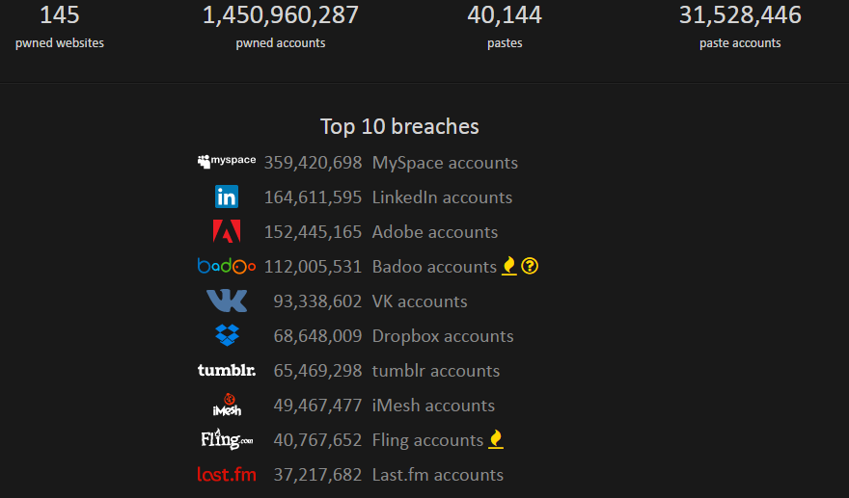
https://haveibeenpwned.com/

Slide 26
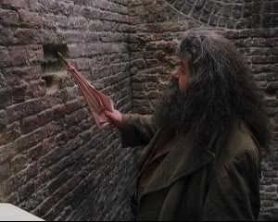
Notes:
Missing functional level access control (administrative pages!)

Slide 27
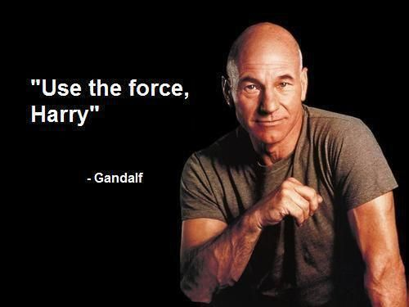
https://www.pinterest.com/pin/481885228855703308/
Notes:
CSRF

Slide 28
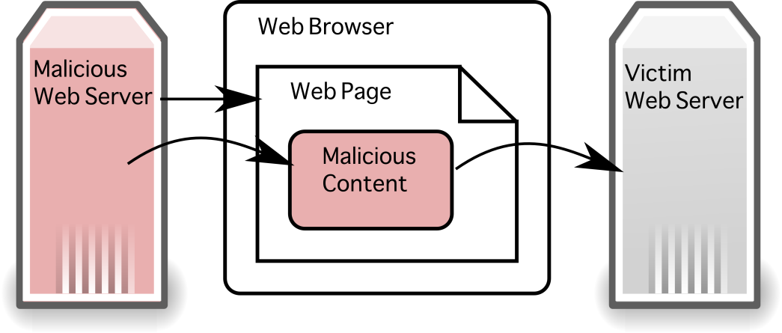

Slide 29

Notes:
Components with known vulnerabilities

Slide 30
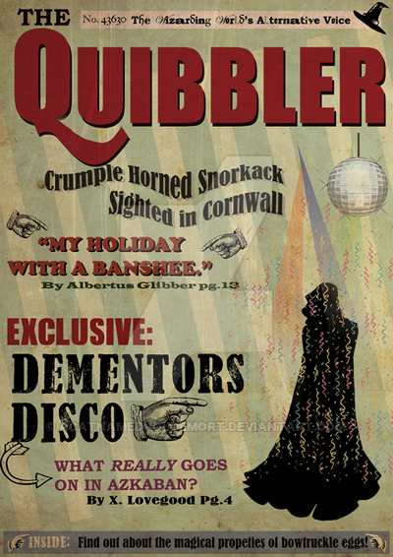
http://www.potterworldmc.com/forum/m/23366915/viewthread/24561719-quibbler
Notes:
Unvalidated redirects & forwards

Slide 31
https://www.owasp.org/index.php/Top_10_2013-Top_10
Injection
Sensitive Data Exposure
Broken Authentication and Session Management
Missing Function Level Access Control
Cross Site Scripting (XSS)
Cross-Site Request Forgery
Insecure Direct Object Reference
Components With Known Vulnerabilities
Security Misconfiguration
Unvalidated Redirects And Forwards

Slide 32
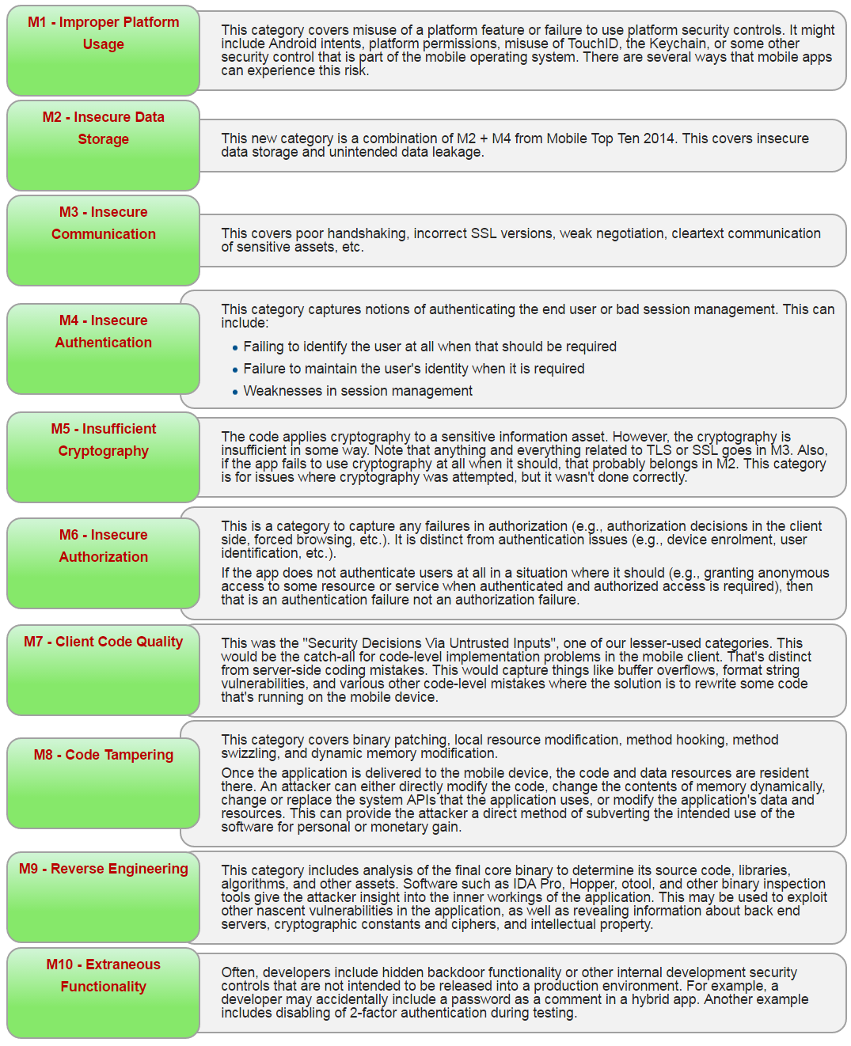
https://www.owasp.org/index.php/Mobile_Top_10_2016-Top_10

Slide 33
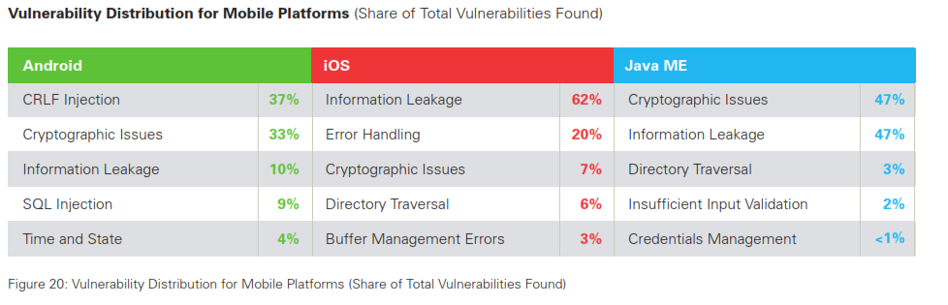
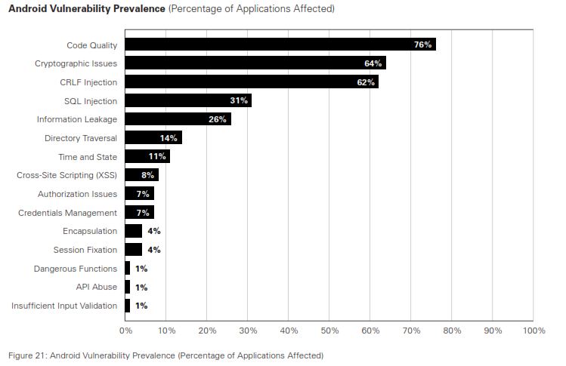
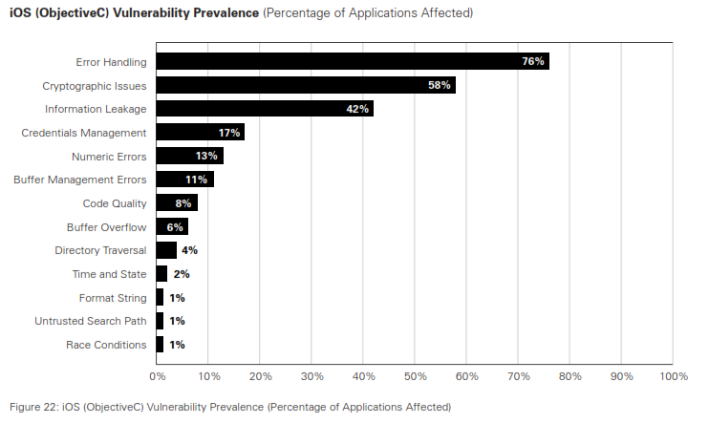

Slide 34
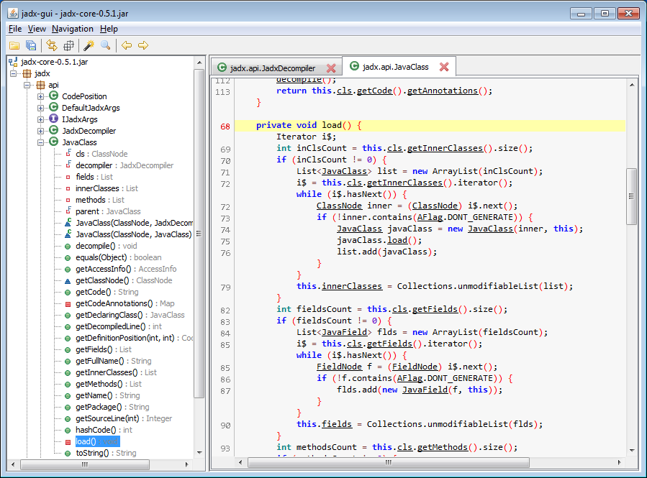
https://github.com/skylot/jadx

Slide 35
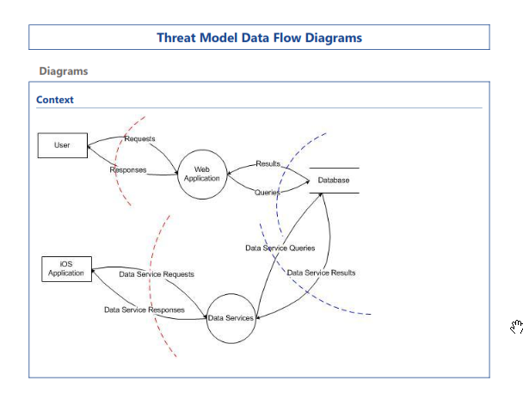
Spoofing
Tampering
Repudiation
Information Disclosure
Denial of Service
Elevation of Privilege

Slide 36




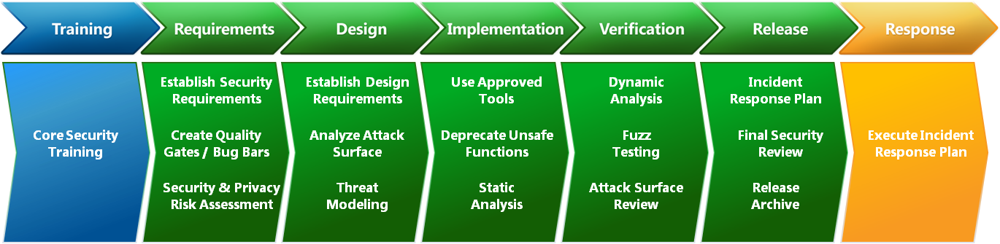
Exploring Information Security podcast,

Slide 37

Notes:
Input is evil

Slide 38

Notes:
100% protection? No, just raise the bar & make it easier to find someone else.

Slide 39

Notes:
Questions

Slide 40
References
http://www.troyhunt.com
http://www.troyhunt.com/2011/12/free-ebook-owasp-top-10-for-net.html
http://www.owasp.org
http://www.youtube.com/user/AppsecTutorialSeries?feature=watch
http://www.microsoft.com/security/sdl/default.aspx
http://blogs.msdn.com/b/sdl
http://bsimm.com
http://www.amazon.com/Writing-Secure-Second-Michael-Howard/dp/0735617228
http://www.nosqlmap.net/index.html
http://www.veracode.com/resources/state-of-software-security

Slide 41
Tools
https://www.kali.org/
https://www.microsoft.com/en-us/download/details.aspx?id=49168 (Threat Model designer)
http://www.microsoft.com/download/en/details.aspx?displaylang=en&id=21769 (File fuzzer)
WebGoat.NET
https://github.com/sempf/WebGoat.NET
https://github.com/jkuemerle/WebGoat.NET

